Slide 1

Presentation on C# Programs
Presenter- Praveen Chakravarthi

Slide 2
Agenda
Bubble Sort Program
Linear Search Program
Binary Search Program

Slide 3

Bubble Sort Program
using System;
using System.Collections.Generic;
Using System.Linq;
Using System.Text;
Using System.Threading.Tasks;
Namespace BubbleSort
{
// Author : Praveen Chakravarthi
// Purpose : BubbleSort
Internal class Program
{
static void Main(string[] args)
{
// Initialising Array
int[] data = new int[] { 56, 35, 78, 49, 94 };

Slide 4
int temp;
Console.WriteLine("Before Sorting: ");
foreach(var d in data)
{
Console.WriteLine(d);
}
for (int i=0;i<=data.Length-2;i++)
{
for (int j=0;j<=data.Length-2;j++)
{
if(data[j]>data[j+1])
{
temp = data[j + 1];
data[j+1] = data[j];
data[j] = temp;
}

Slide 5
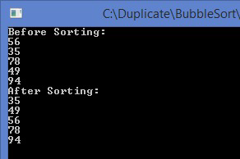
}
}
Console.WriteLine(“After Sorting: “);
data.ToList().ForEach(e => Console.WriteLine€);
Console.ReadLine();
}
}
}
Bubble Sort:
Bubble Sort is a simple Sorting program which swaps the adjacent elements if they are wrong in order, moving the heaviest element to the last followed by number of iterations
Output:

Slide 6

Linear Search Program
using System;
using System.Collections.Generic;
Using System.Linq;
Using System.Text;
Using System.Threading.Tasks;
Namespace LinearSearch
{
// Author : Praveen Chakravarthi
// Purpose : Linear Search Program
internal class Program
{
static void Main(string[] args)
{
// Array initialisation
int[] data = new int[] { 23, 35, 87, 99, 54 };

Slide 7
int input;
// Read Data from user
Console.WriteLine(“Enter any Number to search: “);
input =Convert.ToInt32(Console.ReadLine());
// Logic for Linear Search
for (int i = 0;i<data.Length;i++)
{
if (input == data[i])
{
Console.WriteLine($”The Number {input} is in Index {i} at Position {i+1}”);
Console.ReadLine();
}
}
// If input Number is not Found
Console.WriteLine(“The Number is not found”);

Slide 8
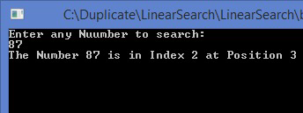
Console.WriteLine("Search Failed");
Console.ReadLine();
}
}
}
Linear Search:
The Linear search is a technique used to search a particular value from a list of values available in an array. The searching starts from the beginning of the array. The linear search compares the entered value with each value in the array one after the other and stops when either the target element is found or the search reaches the end of the array
Output:

Slide 9

Binary Search Program

Slide 10

Thank You !
- Praveen Chakravarthi

